Slide 1
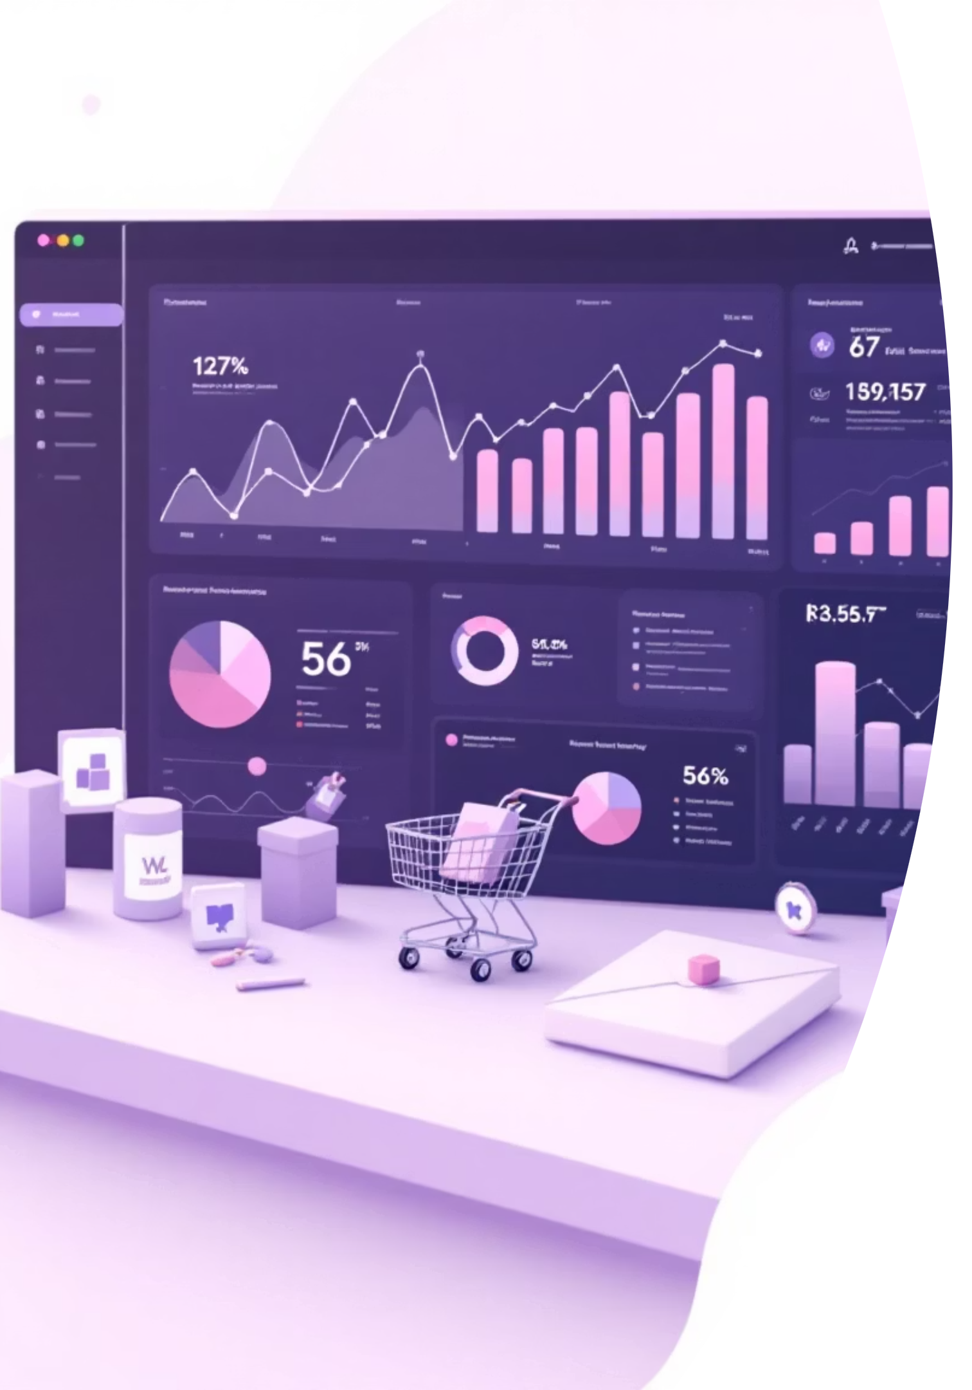
Customer Shopping Behavior Analysis
Uncovering insights from 3,900 purchases to drive strategic business decisions

Slide 2
Dataset Overview
3,900
18
37
Total Purchases
Data Points
Missing Values
Transactions analyzed
Features per customer
In review ratings only
Customer Demographics
Shopping Behavior
Age, Gender, Location
Purchase patterns & frequency
Subscription Status
Discounts & promo codes
Review ratings & shipping

Slide 3

Data Preparation Process
Data Loading
Imported dataset using pandas, explored structure with df.info() and summary statistics
Data Cleaning
Imputed missing review ratings using median by category, standardized column names
Feature Engineering
Created age groups, purchase frequency metrics, removed redundant columns
Database Integration
Connected to PostgreSQL and loaded cleaned data for SQL analysis

Slide 4
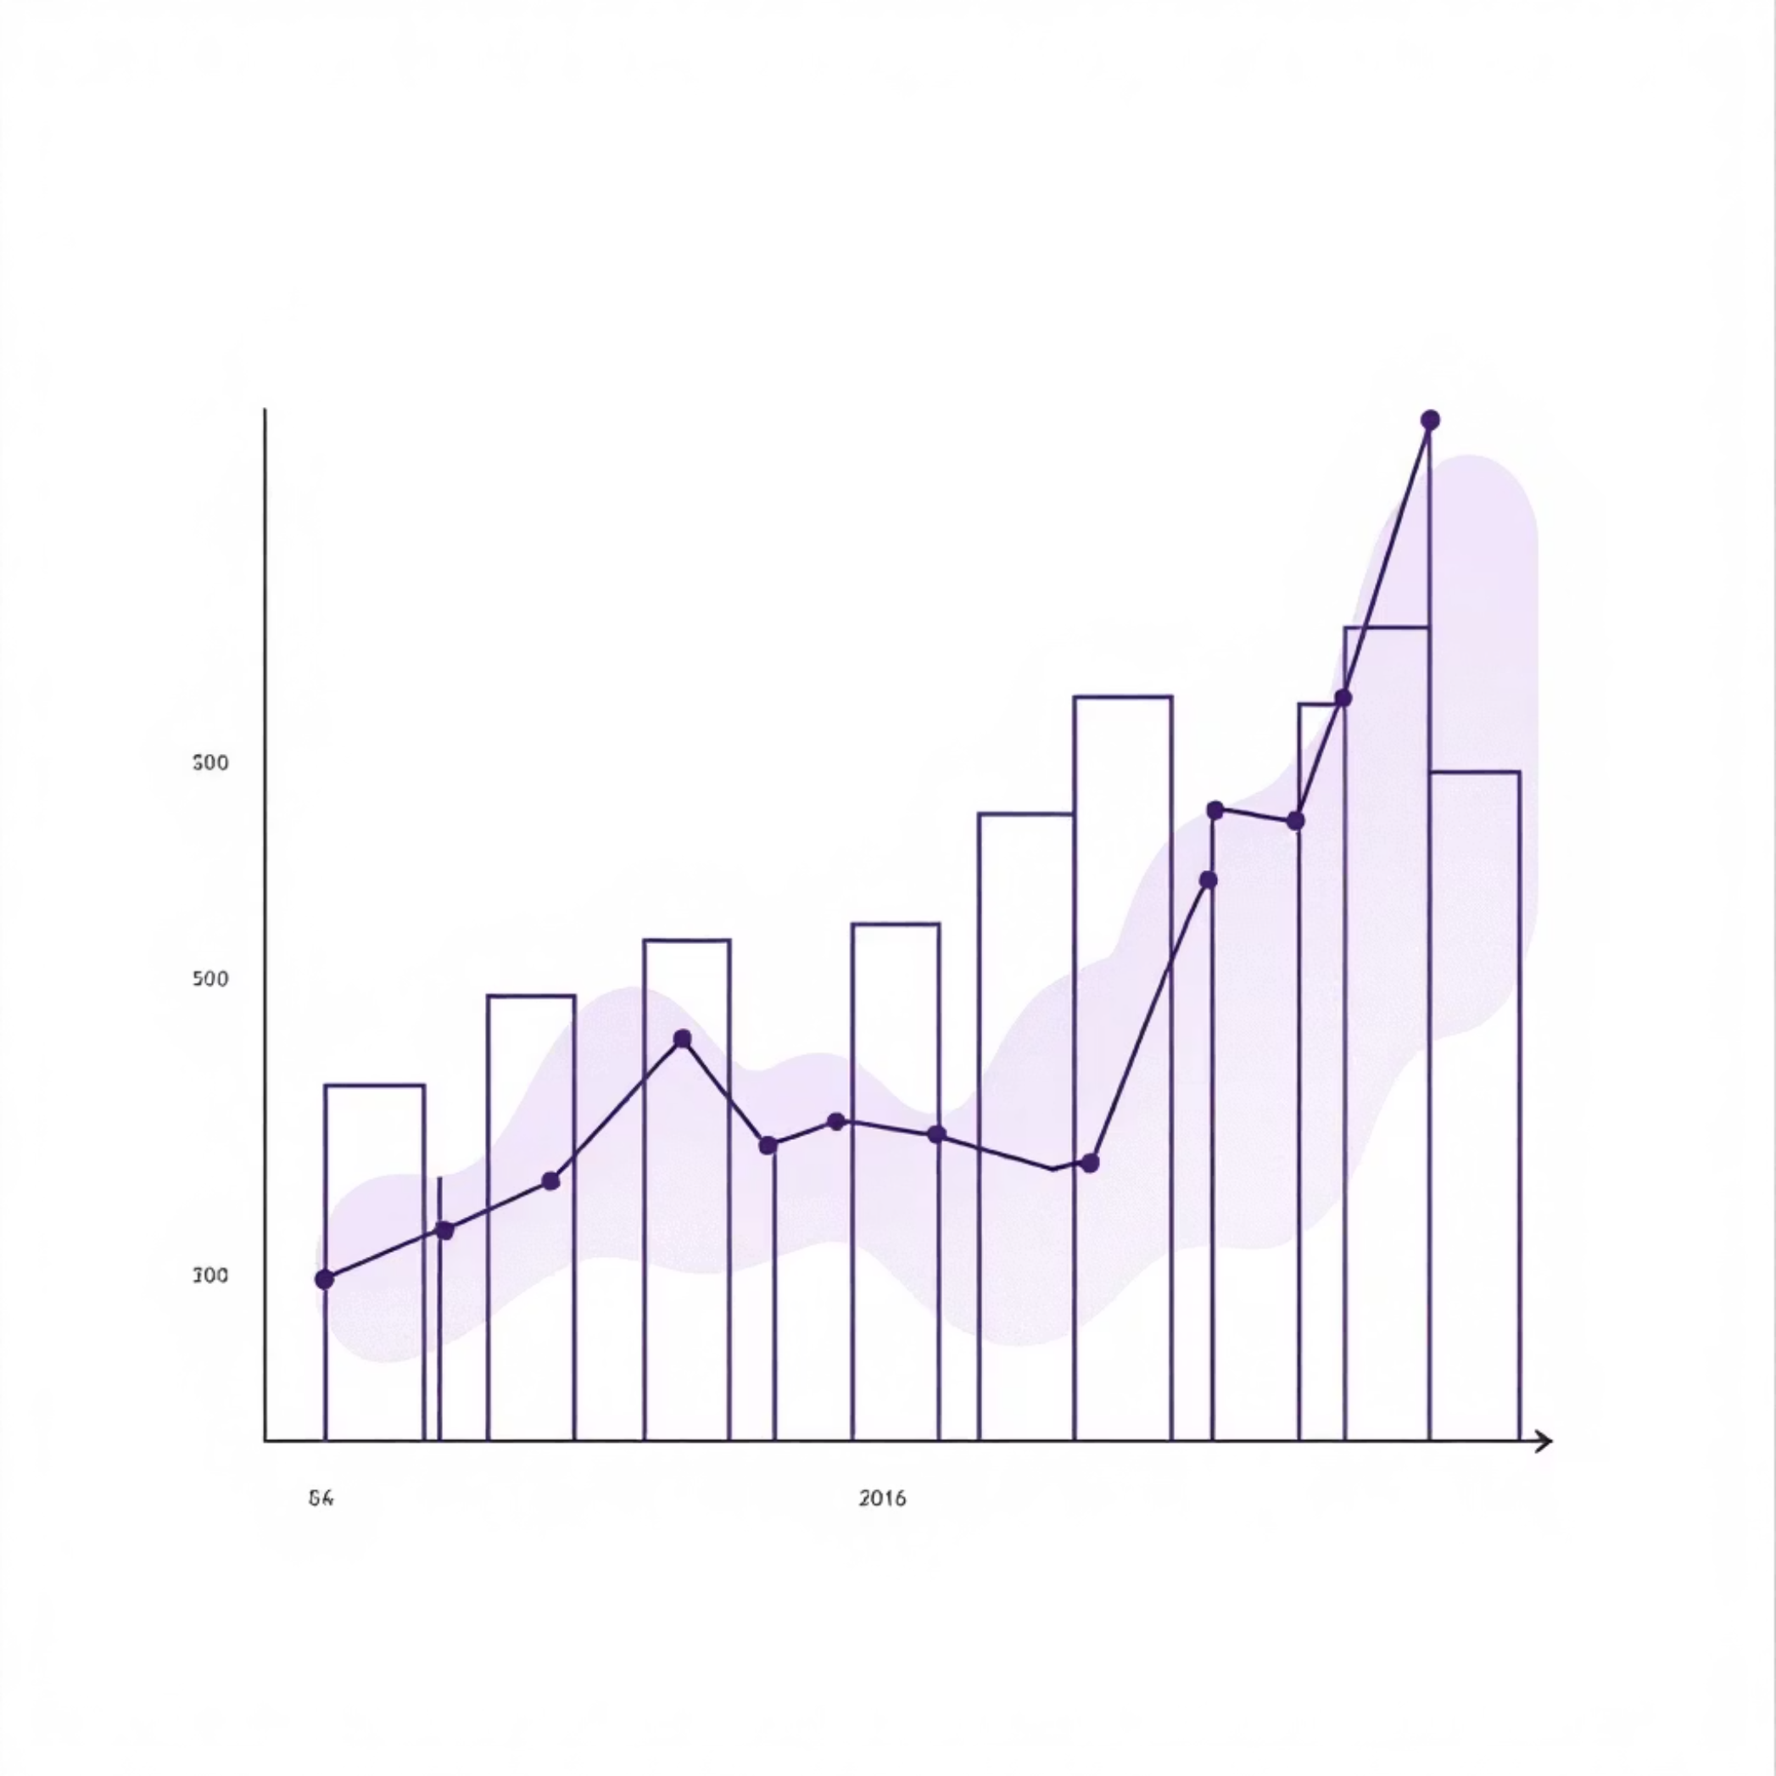
Revenue Insights
Revenue by Gender
Male customers generate slightly higher total revenue than female customers
Shipping Analysis
Express shipping users show higher average purchase amounts vs. Standard

Slide 5

Customer Segmentation
New Customers
Returning Customers
Loyal Customers
First-time buyers exploring product range
2-5 purchases, building loyalty
5+ purchases, highest lifetime value
Repeat buyers with 5+ purchases show significantly higher subscription rates

Slide 6


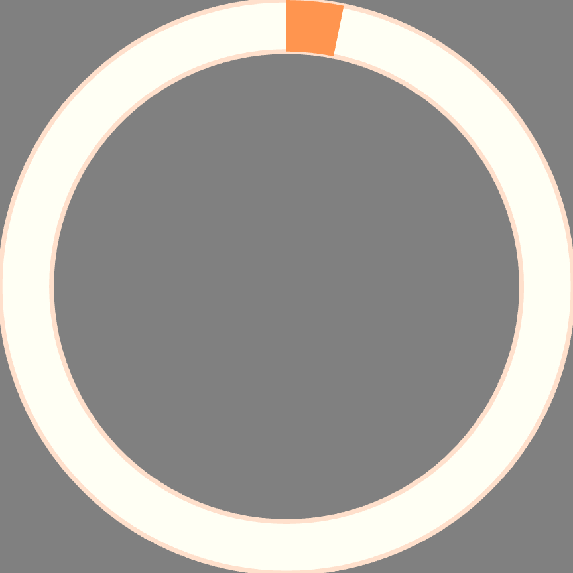
Subscription Impact
68%
45%
3.2x
Higher Spend
Revenue Share
Purchase Frequency
Subscribers spend more per transaction on average
Subscribers contribute nearly half of total revenue
Subscribers buy more frequently than non-subscribers
Subscription status is a key driver of customer lifetime value and repeat purchases

Slide 7
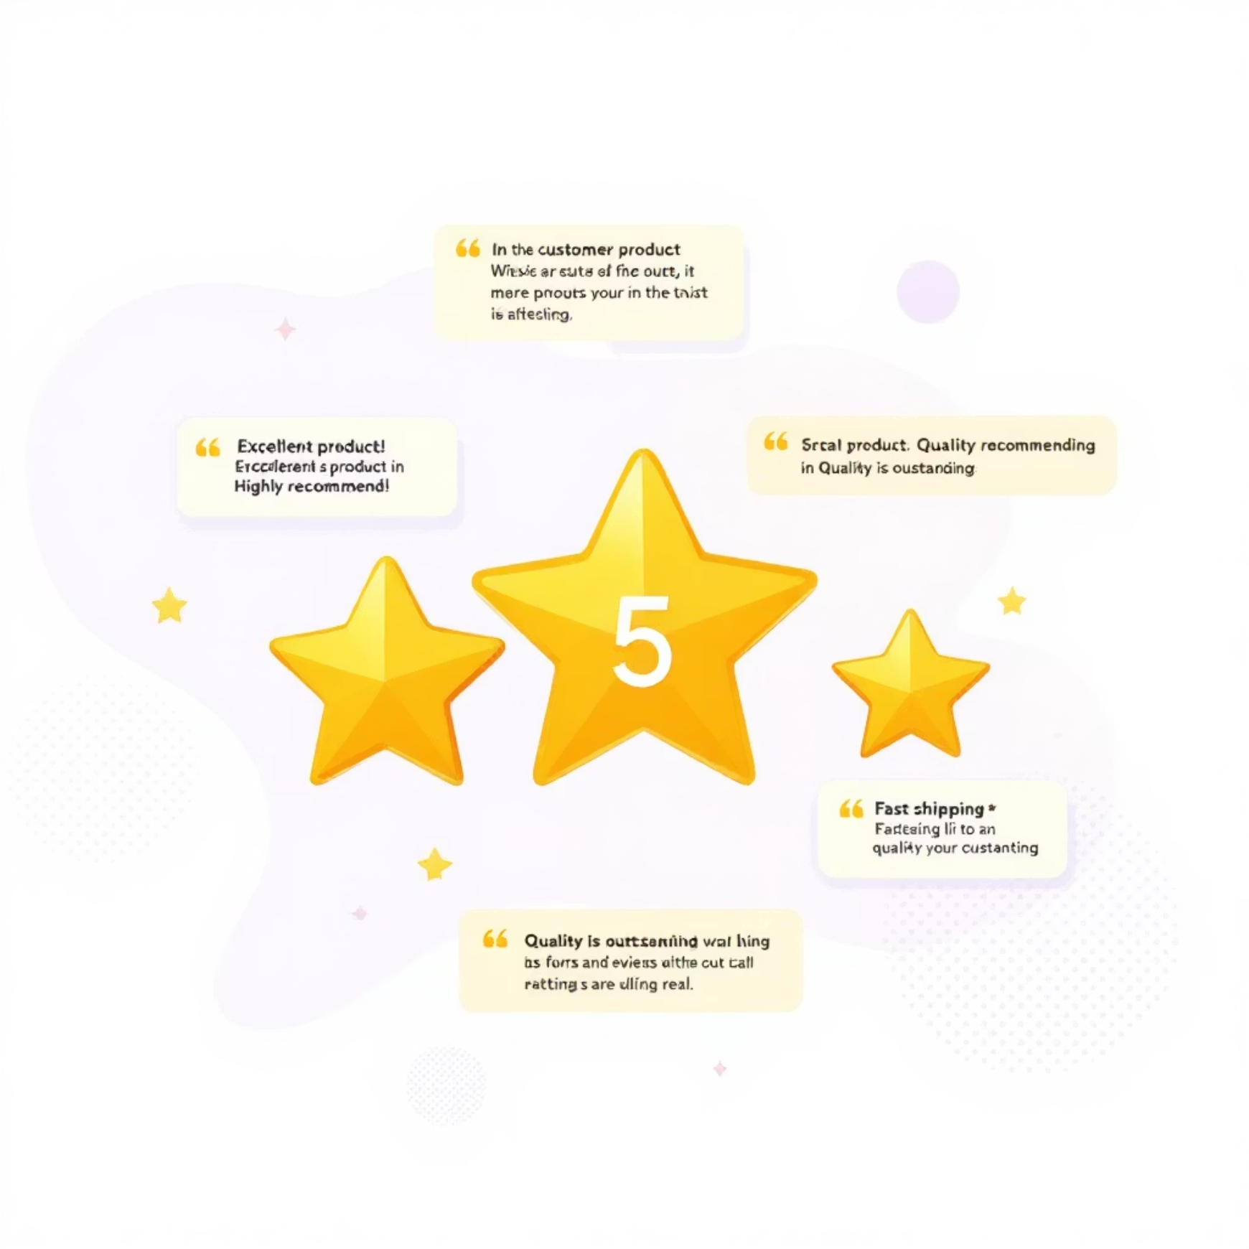

Product Performance
Top-Rated Products
Discount Dependency
5 products achieved highest average review ratings, driving customer satisfaction
5 products show highest percentage of discounted purchases
Top 3 products identified per category based on purchase volume

Slide 8
Age Group Revenue Contribution
35%
28%
25-34 Years
35-44 Years
Highest revenue generation
Second largest contributor
22%
15%
18-24 Years
45+ Years
Growing segment potential
Stable customer base

Slide 9
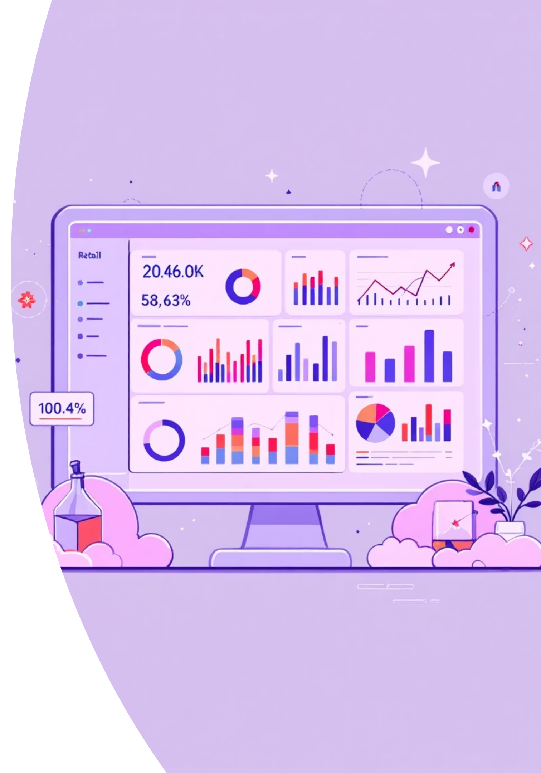
Interactive Dashboard
Real-Time Insights
Track revenue, customer segments, and product performance dynamically
Visual Storytelling
Interactive charts reveal patterns in shopping behavior and preferences

Slide 10
Strategic Recommendations
Boost Subscriptions
Loyalty Programs
Review Discounts
Promote exclusive benefits to convert high-frequency buyers
Reward repeat buyers to move them into loyal segment
Balance sales boosts with margin control for sustainable growth
Targeted Marketing
Product Positioning
Focus on high-revenue age groups and express-shipping users
Highlight top-rated and best-selling products in campaigns

